Slide 1

Digital scholarship portal
Mohammed Fayiz mk
Devika gireesh a
27.05.22

Slide 2

Agenda
INTRODUCTION
USERS
COMPONENTS
DEPLOYMENT
CONCLUSION

Slide 3
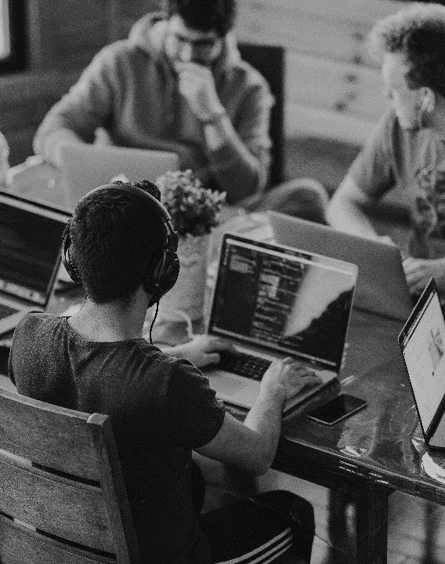
INTRODUCTION
More than 10,000 students apply for scholarships every year.
Applying for them is a time consuming and difficult process.
A solution where both students can submit the application and institution can verify them.
Single student can apply for multiple scholarships

Slide 4
users
STUDENT
Can apply for different scholarships
Upload required documents
INSTITUTION
Verify the student requirements.
Forward the approval to provider.
PROVIDER
View the application.
Approve or Reject.

Slide 5
MODULES
LOGIN
STUDENT-PROFILE
INSTITUTE-PROFILE
PROVIDER PROFILE

Slide 6
DEPLOYMENT
Any database can be connected such as MySQL.
If we can connect to a free cloud platform such as Heroku, we can deploy it there.

Slide 7
DEPLOYMENT
Any database can be connected such as MySQL.
If we can connect to a free cloud platform such as Heroku, we can deploy it there.

Slide 8
conclusion
Front end of the application is completed.
Requires Backend and hosting Server.

Slide 9



THANK YOU
Team_8
+91 8129901708
fayizmk20@gmail.com

